Slide 1
If your name is below – please take your belongings with you and meet at the front.
Chunyang Cai
Canru Miao
Qingyang Zhang
Joshua Montes
Rishikesh Chari
Jiayu Chen
Zhuoxuan Li
Yuanhao Li
Shenyu Li
Yuezhipeng Zhang
Abdullah Alatawneh
Yanxin Wang
Nawaf Alghusson
Tianrui Wang
Yiwei Zhao
Yichen Li
Zhiyu Yuan
Gengchen Fan

Slide 2
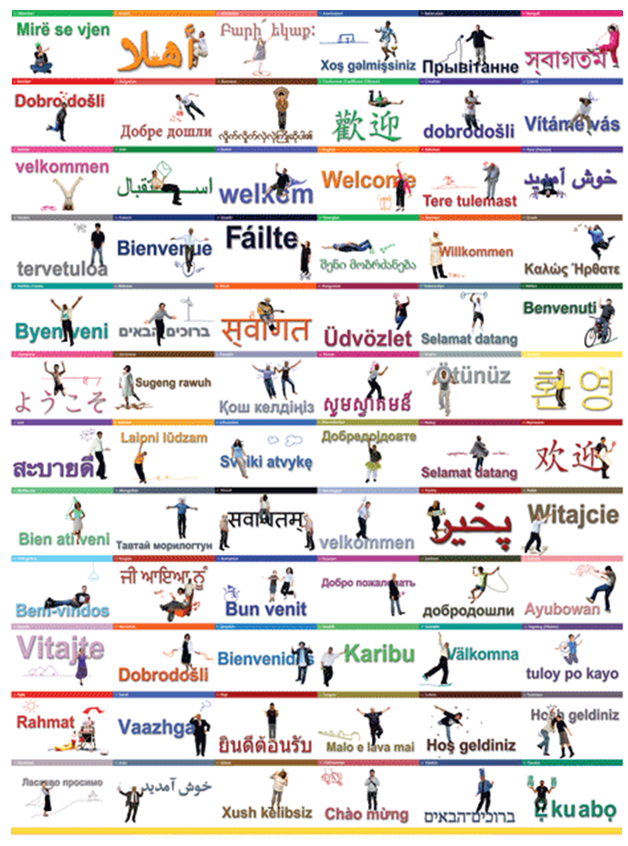
Notes:
Welcome!

Slide 3
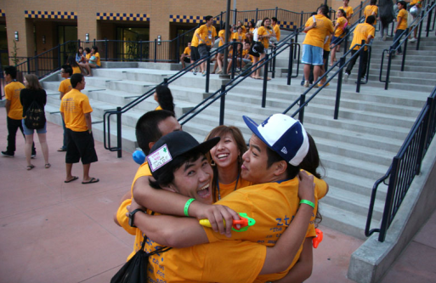
What we will discuss:
Introductions …
Peer Academic Counselors
vs.
International Peer Group (IPG) mentors
- Where to get help if I need it
- UC Irvine and Orange County, California
- Review of requirements for a Bachelor’s degree
- How to keep track of my degree requirements
- Cheating and plagiarism

Slide 4
Where do you go to get help? Physical Sciences Student Affairs!!
Mon. – Fri. 9am – 4pm
Phone: (949) 824-6507
Drop in: Rowland Hall, room 134
Email: pssazot@uci.edu
Website: ps.uci.edu/stuaff

Slide 5
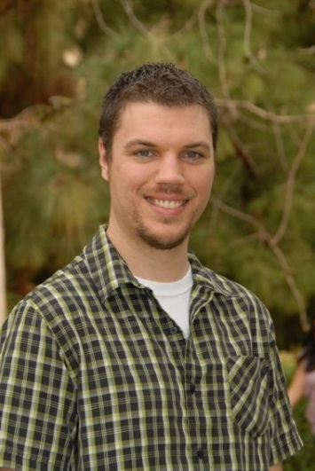
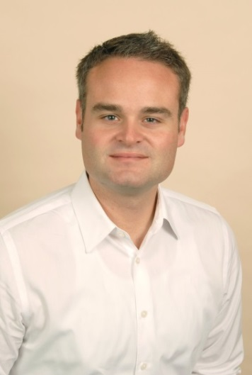
Academic Counselors
Don Williams, Mike Tawney, Jillian LeMaster-Dwyer, Stefanie Masuda, Cindy Fern
Associate Deans
David Van Vranken
Professor of Chemistry
Roger McWilliams
Professor of Physics and Astronomy
Peer Academic Advisors
Alyssa Powers, B.S. Physics
Claire Urata, B.S. Mathematics
Alessandra Flaherty, B.A. French & B.S. Chemistry
Emma Wilfong, B.S. Chemistry & Public Health Sciences Shelly Meirovitch, B.S. Mathematics
Office Coordinator
Jhealyn Rogers

Slide 6
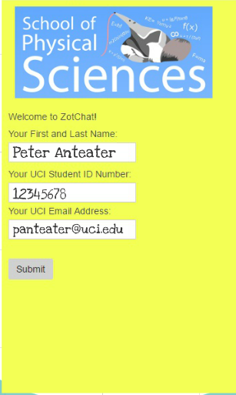
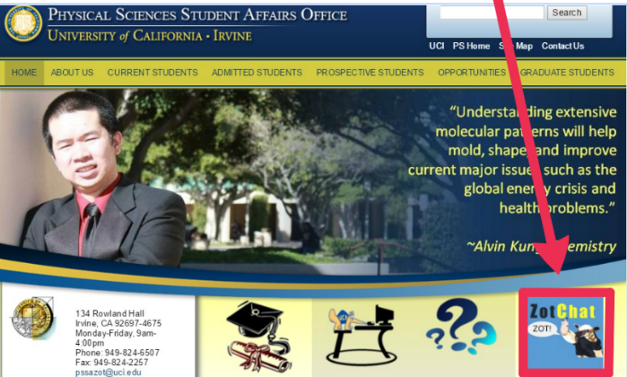
Zot Chat

Slide 7
Peer Academic Advisor (PAA)/ Academic Counselor
vs.
International Peer Group (IPG) mentors
Questions for PAAs or Academic Counselors:
• Which classes do I need to graduate?
• Why can I not enroll in this class?
• How do I get involved in research?
• What do I do if I want to go to pharmacy school?
• How do I apply for a minor?
Questions for IPG mentors:
• Where can I get a new iPhone ?
• Where is the best sushi in Irvine?
• What time does the library close?
• How do I use the bus?
• I don’t like my roommate, what should I do?

Slide 8
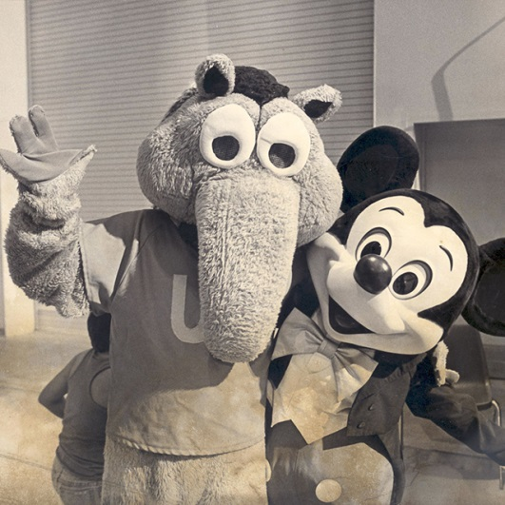
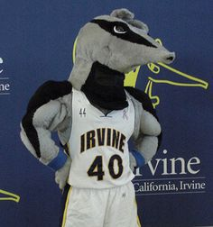
UC Irvine was ranked 1st among U.S. universities under 50 years old by Times Higher Education. UC Irvine is ranked 7th among public U.S. universities by the U.S. News and World Report (we are tied with UCSD). UCI has 29,000 students and 193 degrees offered.
1965
2015
Notes:
In U.S. News & World Report’s “Best Colleges 2011 Rankings” released August, 2012, UC Irvine is 12th among public universities. Among all universities, public and private, UC Irvine leaped five places to 41st (from 46th in 2010.)

Slide 9
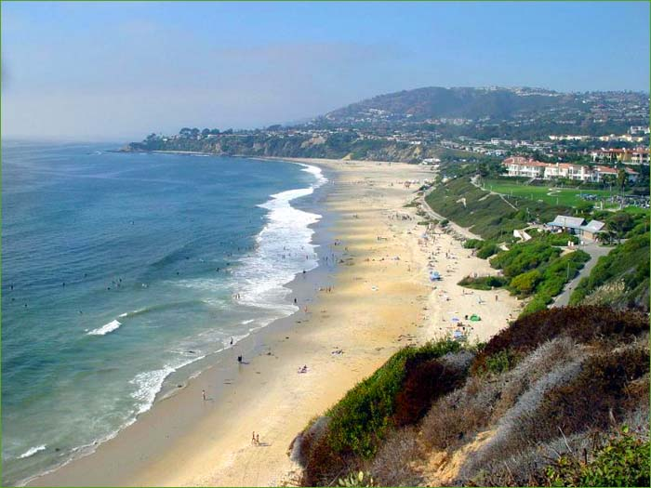
Fun places to visit after you’ve finished studying!
Go to the beach!
Go to the movies & go shopping!
Disneyland, Angel’s Stadium, and Knott’s Berry Farm are only 15 minutes away!
Notes:
Go to the beach - The UCI campus is located about 3 kilometers from the Pacific Ocean and is close to the famous beach communities of Newport Beach, Laguna Beach, and Huntington Beach, known officially as “Surf City.”
Go to the movies & go shopping – There are several entertainment districts, malls, theaters, all within 15 minutes of UCI – there’s Fashion Island, the Irvine Spectrum, South Coast Plaza, and the University Center just to name a few!

Slide 10
UCI—An International Focus
80 different languages spoken on campus
70% of students have at least one parent born outside the U.S.
20% of students are born outside of the U.S.
Globally renowned faculty from many different countries
Notes:
UCI’s students are among the most diverse and internationally-oriented of any U.S. university. The University’s reputation is strong throughout the world.

Slide 11
Ethnicity of UCI Students
Ethnicity | Percent (approximate)
Asian/Asian American | 55%
Chicano/Latino | 23%
White/Caucasian | 16%
Unknown/Other | 3%
Black | 3%
Notes:
The ethnic diversity of UC Irvine’s student body reflects the State of California’s population. Over half of our students are of Asian/Pacific Islander descent. This diversity reflects the “new USA,” in which the white, non-Hispanic population will soon be under 50%.

Slide 12
Very Quick Review of what is required to complete your bachelor’s degree.

Slide 13
UC and UCI Requirements
Entry Level Writing (ELW)
American History & Institutions
Minimum 180 quarter units
Minimum 2.0 GPA
General Education
Categories I – VIII
Major/Degree Requirements
Listed in catalogue and degree
Online UCI Catalogue: http://catalogue.uci.edu/
(The catalogue is your contract with the University. You’ll find lots of important information in it.)

Slide 14
Entry Level Writing (ELW)
You have taken the Academic English Placement test.
After that test is graded, you will know which Academic English course to take. The test is to be graded before fall quarter begins.
After you pass the Academic English course(s), you will take Writing 39A. It may take several quarters before this happens.
American History and Institutions
Complete one year of college-level United States history with grades of C or better, or one course in United States history and one in United States government with grades of C or better. Acceptable UCI courses: United States history—History 40A, 40B, 40C; United States government—Political Science 21A.
If you went to High School in the US, you have probably completed this requirement.

Slide 15
More about Entry Level Writing
Entry Level Writing (you must get a C or better to pass)
Lower-Division Writing (you must get a C or better to pass)
Academic English
20A
20B
Writing 39B
Writing 39C
Writing 39A
20C
20D
29
If you were placed into Academic English, then you must take an Academic English or Writing class every quarter until you complete Lower-Division Writing. No exceptions.

Slide 16
General Education Requirements– 8 Categories
(see pink handout)
Category I: Writing
Two lower-division writing courses
(beyond the UC Entry Level Writing requirement
-must complete Writing 39A first) usually 39B and 39C.
One upper-division writing course, usually senior year
Category II: Natural Sciences
Three courses--Physical Sciences majors complete this with their degree requirements, either Chemistry or Physics (except Env. Sci & Policy)
Category III: Social and Behavioral Sciences
Three courses from approved GE list*
Category IV: Arts and Humanities
Three courses from approved GE list*

Slide 17
General Education – continued
Category V: Quantitative, Symbolic, and Computational Reasoning (Va-Quantitative Literacy,Vb-Formal Reasoning)
Three courses--Physical Sciences majors complete this with their mathematics requirements (except Env. Sci & Policy majors
Category VI: Language other than English
Satisfied if you completed one year of formal schooling at the 6th grade level or higher at a school where the language of instruction is not English.
Category VII: Multicultural Studies
One course from approved GE list*
Category VIII: International/Global Issues
Satisfied if you completed two years of formal schooling at the 6th grade level or higher at a school where the language of instruction is not English.
* Note: You can overlap courses to satisfy GE, if they appear in both categories (except for categories III and IV – courses cannot overlap between these two categories).

Slide 18
How to use your Student Access account…

Slide 19
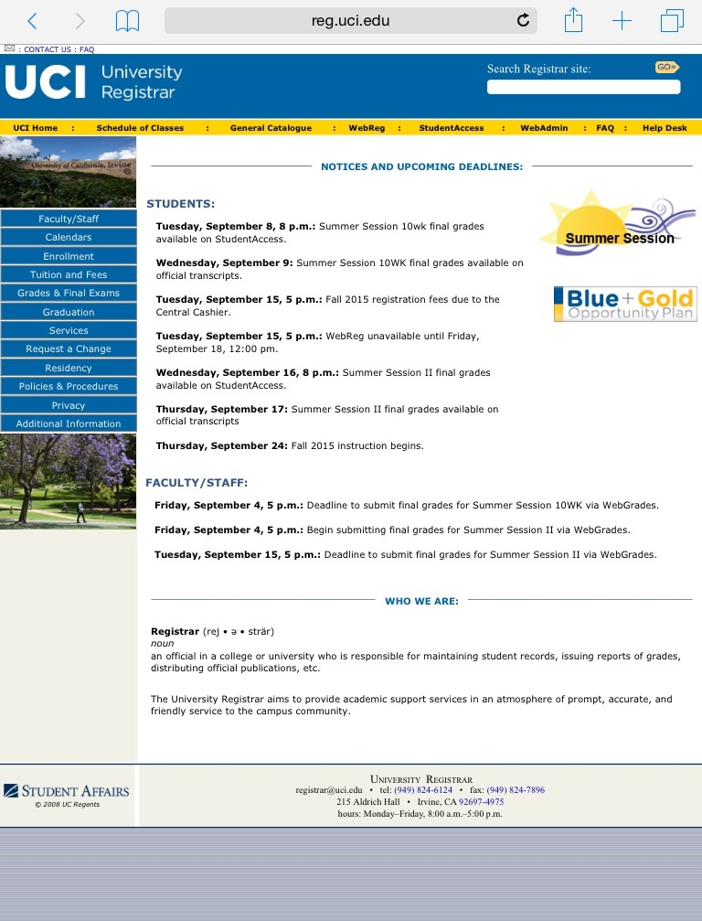
Step 1: Go to reg.uci.edu and click on “Student Access”

Slide 20
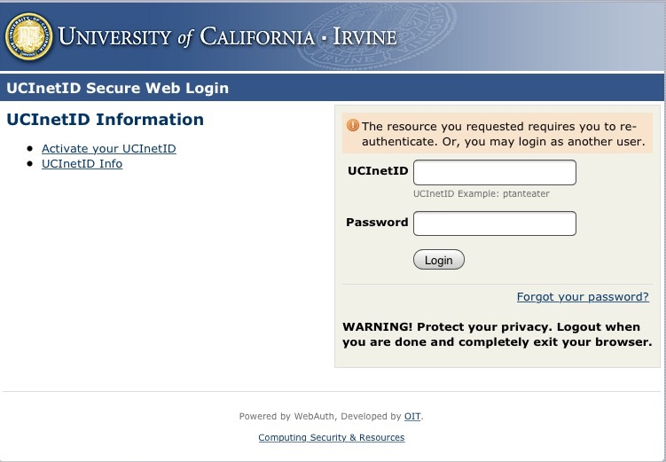
Step 2: Log-in with your UCInetID and Password

Slide 21
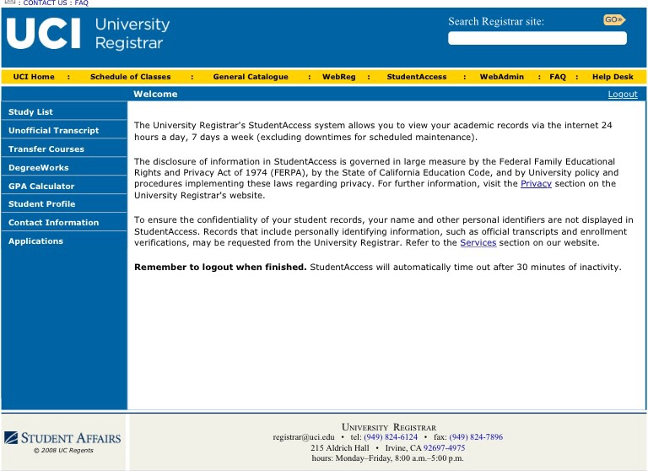
Step 3: You’re on your Student Access account!
Now let’s take a look at DegreeWorks!

Slide 22
Degree Works (Degree Audit)
How to keep track of what you’ve completed.

Slide 23
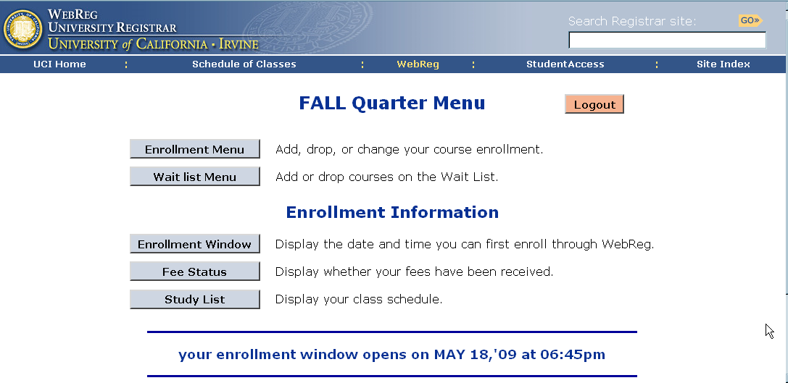
You should already be enrolled in most of your classes for the fall quarter…
When do you enroll for the winter quarter?
~ SOC becomes available Week 6 ~ Check WebReg for
Enrollment Window during Week 7 ~ Enrollment Windows open starting Week 8

Slide 24
Notes:
In Spring 2015, the School of Physical Sciences caught 20 students cheating. 9 of these students were dismissed and will not be allowed to return to ANY UC campus – ever. The rest of the students were suspended for at least 2 quarters. Every single student that was caught was an international student.

Slide 25
Let’s Play a Game Called: Is this cheating?
1) I struggle with English and so, my friend who is good at English told me what to write for my essay. They did not write my essay, but my essay topic was not my idea. Is this cheating?
2) My friend turned to me during my exam and asked me, “Can I copy off of you?” I did not say anything and I did NOT let them see my exam. After the exam I told the professor what had happened. Is this cheating?
3) I had a surgery this quarter and my parents got divorced. My friend wanted to help me, so they did my homework for me. Is this cheating?
4) I hired someone to take my math final because I had to go home to deal with problems that I was having with my boyfriend. Is this cheating?
Notes:
YES! This is cheating! Anything that you put your name on should be 100% your own work.
NO! You should never talk during an exam, even if it is to say ‘no.’ If someone asks to cheat off of you, you must inform your professor. If you do not tell your professor and that person cheats on you without your permission, you can still get in trouble.
YES!
1000X YES!! This is one of the most egregious forms of cheating. If you do this just one time, you could be dismissed.
Your friends can help you LEARN the material. They cannot help you DO the material.

Slide 26
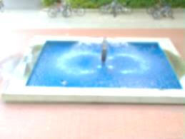
Before the quarter begins ...
Get your Student ID at the UCI Bookstore.
Check your study list for any classroom changes
Find out where all your classes are located—walk around and find you buildings
Go to the ‘Student Access’ website and review features
Check your UCI email regularly. Go to www.oit.uci.edu to set it up.
Get a parking permit, if applicable. Go to www.parking.uci.edu.

Slide 27
Welcome Week (Sept 24-28)
Plan to attend these special events on Monday, September 24th:
9:15 a.m.: New Student Convocation in the Bren Events Center
10:30 a.m.: Dean’s Welcome
11 a.m.: Meet Department faculty
12 noon: Anteater Fair in Aldrich Park
~Classes start on Thursday, September 27th~
(lectures only, no discussions or labs)

Slide 28
What you should take away from our session today…
You need to take AE/Writing every quarter, no exceptions.
You need to be enrolled in at least 12 units per quarter.
The add, drop, and grade change deadline is 5pm on Friday of Week 2.
Check your UCI email daily. You need to always email us from your UCI email (and please include your UCI ID number in your emails!)
Visa/Immigration related questions should be directed to the UCI International Center.
AP/IB/A-Level Scores need to be submitted to UCI Admissions by 10/31/2018. Hold will be placed if not received.
If you have questions, visit our office!
DO NOT CHEAT. YOU ARE NEVER EVER EVER ALLOWED TO CHEAT. EVER.
Notes:
What will happen if they do not take AE or if they fail AE
If you do not take 12 units per quarter, then you will be in big trouble with the International Center
This deadline is final.
Really, actually do this.
We caught 20 students cheating in Spring quarter. All of them were international students. None of these students will be returning in the fall, and 9 of these students are never allowed to attend a UC ever again.

Slide 29
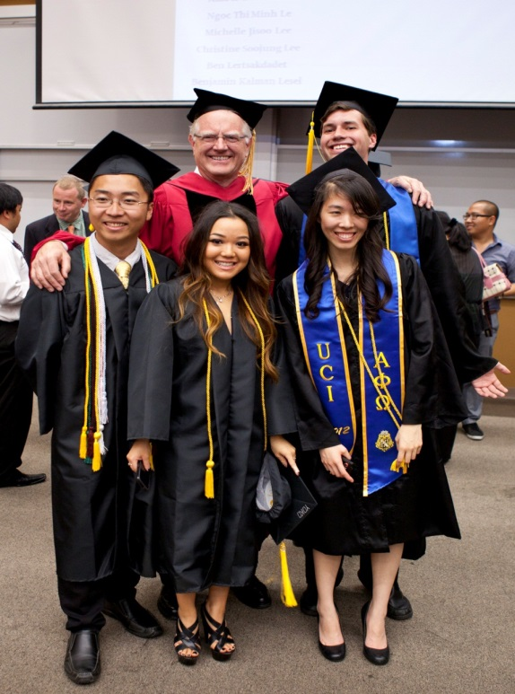
If you listen to us, then this will be you in 4 years!

Slide 32
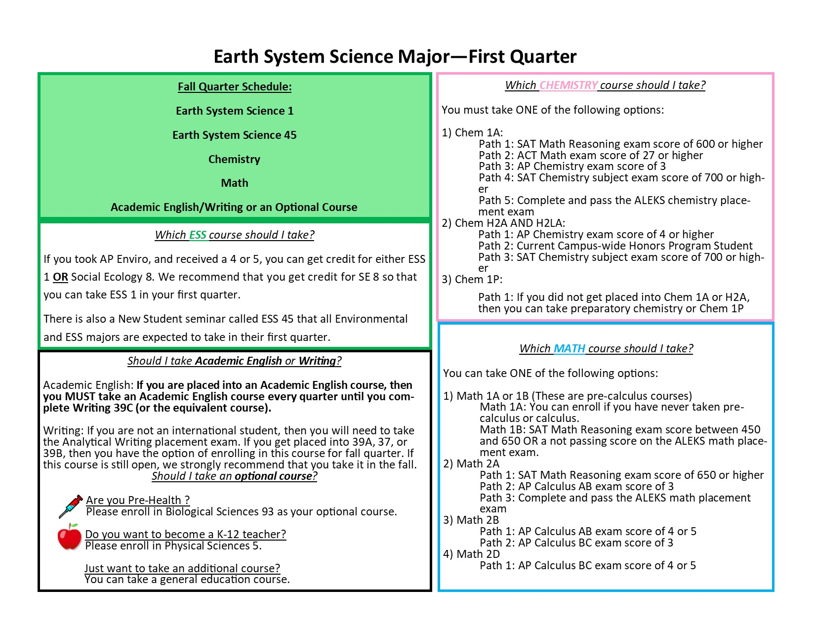

Slide 35
If your name is below – see me before you leave today!
Fangyuan Wu
Siyuan Gu
Yueyue Yu
Lin Gan
Aijia Dong
Zhongqi Zhang
Yixuan Xiao
Longge Shao
Yifan Zhang
Binrui Shan
Mingxuan Nie
Kuan Ling
Jie Ma
Yongdai Gu
Yiqing Zhang
Tianrui Wang
Chenjie Wang
Lanru Fu
Susu Rong
Fukun Yun
Tianyi Xie
Fengyi Gu
Qingqing Yu
Zicong Ni
Yutong Lan
Xiangbo Gao
Yuqi Fang

Slide 36
If your name was not listed, and you have questions, you will need to visit our office starting tomorrow at 9am-12pm & 1-4pm for any questions. We are located in 134 Rowland Hall and will be available to assist you at this time.

